Slide 1

November 23, 2025
Team Number: 5
Students: Benjamin Guerrero, Max McCartney, Erika Mendes

Slide 2
Buy CLH 6.375% 2/01/31
Investment Summary
Bond Info
Moody’s/S&P/Fitch | Ba2/BB+/BB+
Issue Size ($M) | $500
OAS (bps) | 176
YTW | 5.23%
Convexity | 0.05
Modified Duration | 1.99
Thesis 1:
Durable Competitive Advantage Will Drive Strong Credit Metrics Through 2027 and Support a Potential Ratings Upgrade in 2027
Thesis 2:
Clean Harbors Will be Able to Maintain its Strong Credit Profile Even After Financing 2026 and 2027 Acquisitions
 | Bull | Base | Bear
2Y HPR (Annualized) | 6.42% | 6.10% | 5.43%
Source(s): Bloomberg, FactSet, Company Filings

Slide 3
Company Overview

Slide 4
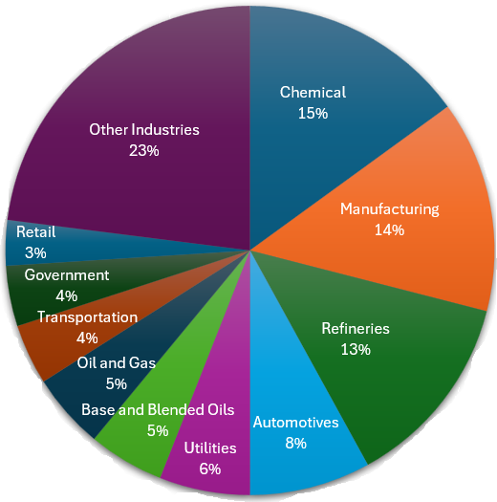
Company Overview
Clean Harbors (CLH) is North America’s leading provider of environmental and industrial services, specializing in hazardous waste management, sustainability solutions, and emergency response.
Revenue Segments
Customer Base
Environmental Services Segment (ES)
Provider of hazardous and non-hazardous waste management services across North America
Safety-Kleen Sustainability Solutions Segment (SKSS)
Re-refines used oil to produce high quality lubricants
CLH’s revenue streams are diversified across a wide range of end markets
Source(s): Bloomberg, FactSet, Company Filings
Notes:
Capital Allocation Strategy: organic growth investments through capex, acquisitions and divestitures, share repurchases, debt repayment
End Market

Slide 5
Company Overview
Clean Harbors (CLH) has continued to show resilient financial momentum with 12% revenue CAGR and 14% EBITDA CAGR since 2021. The environmental services segment remains the core earnings engine, consistently representing a majority of CLH’s sales.
12% CAGR
14% CAGR
Source(s): Bloomberg, FactSet, Company Filings
Notes:
Capital Allocation Strategy: organic growth investments through capex, acquisitions and divestitures, share repurchases, debt repayment
End Market

Slide 6
Upgrade and Downgrade Triggers
Moody’s (Ba1/Stable) | S&P (BB+/Stable)
Upgrade Triggers: EBITDA margin approaching 25% FCF to debt sustained above 12.5% Total Debt/EBITDA below 3.0x | Upgrade Triggers: FOCF/Debt exceeds and sustains above 20%. Management moves to establishing and maintaining investment grade policies and credit measures.
Downgrade Triggers: Debt/EBITDA > 3.5x FCF to Debt < 7.5% Materially lower incinerator utilization rate (typically high 80% range). | Downgrade Triggers: Leverage > 4.0x through decline in sales or operating margins. Clean Harbors pursues a series of bolt-on acquisitions or shareholder rewards, weakening credit metrics.
Source(s): Moody’s, S&P

Slide 7
Capital Structure, Liquidity Model, and Credit Statistics
Source(s): Bloomberg, FactSet, Company Filings

Slide 8
Investment Thesis

Slide 9
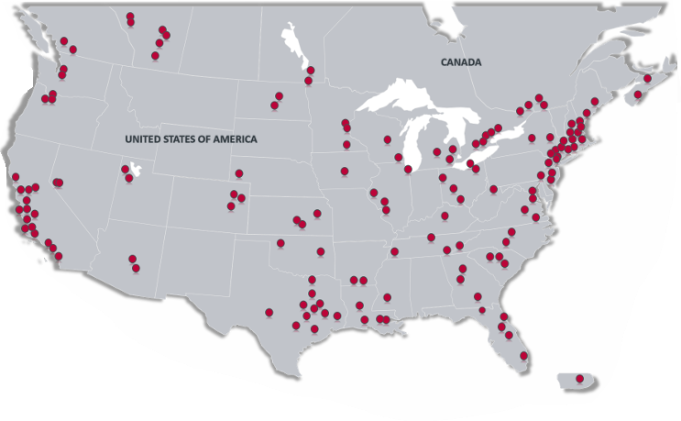
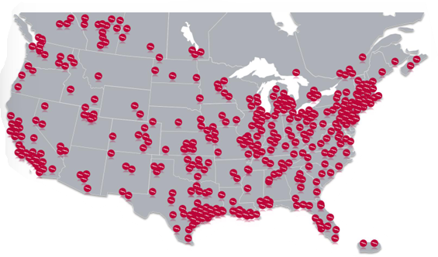
Geographic Breakdown
Only national provider offering a full breadth of environmental and industrial services.
Network of Disposal Assets:
10 hazardous waste incinerators
7 commercial landfill sites
33 Treatment, Storage & Disposal Facilities (TSDFs)
11 Wastewater Treatment Operations
Over 100 waste management facilities
Over 20,000 company vehicles
Disposal Assets
Geographic Reach:
Service locations across all 50 U.S. states, 9 Canadian provinces, and Puerto Rico
Service Locations
Source(s): Bloomberg, FactSet, Company Filings
Notes:
5 high-temperature hazardous waste incineration facilities across the U.S. and Canada
Aragonite, UT; Deer Park, TX; El Dorado, AR; Sarnia, ON; and Kimball, NE
7 landfills, 11 wastewater treatment facilities (9 owned, 1 leased), 33 treatment, storage, and disposal facilities (TSDFs; 30 owned, 3 leased), 8 facilities specializing in solvent recovery (7 owned, 1 leased), 90 oil terminals (53 owned, 37 leased), 9 oil refineries (all owned), 4 oil packaging and blending facilities (3 owned, 1 leased)

Slide 10
Thesis Point 1: Durable Competitive Advantage Will Drive Strong Credit Metrics Through 2027 and Support a Potential Ratings Upgrade in 2027
Scale and Infrastructure Advantage
Scale drives operational leverage and pricing power, with utilization above 89% and margins near 19% EBITDA The new Kimball incinerator (+70k tons capacity) boosts throughput and PFAS* destruction capability, supporting long-term growth and higher FCF generation
PFAS Expansion
Only U.S. provider offering end-to-end PFAS lifecycle management, with > 99.99% destruction efficiency Regulatory framework tailwinds provide recurring revenue opportunities
Oligopolistic Industry Structure
Portfolio of 500+ permits, regulatory hurdles, and high upfront capital requirements limit new entrants and protects incumbents Competitors such as Waste Management and GFL Environmental lack the same hazardous waste footprint
*PFAS: per- and poly-fluorinated alkyl substances
Source(s): Bloomberg, FactSet, Company Filings

Slide 11
Thesis Point 1: Clean Harbor margin expansion, improving cash generation, and disciplined leverage management position CLH to exceed key upgrade thresholds.
Dominant Competitive Positioning Allows CLH to Surpass Upgrade Triggers by 2027
 | 2021 | 2022 | 2023 | 2024 | LTM | 2025E | 2026E | 2027E
EBITDA Margin | 17.5% | 19.7% | 18.7% | 19.0% | 19.2% | 19.4% | 21.6% | 22.4%
Increasing volumes, margins, and synergies should drive EBITDA margins toward 25%
Gross leverage is expected to be <3.0x and FOCF/Debt is expected to be >20% in 2026
Source(s): Bloomberg, FactSet, Company Filings

Slide 12
Thesis Point 2: Clean Harbors Will be Able to Maintain its Strong Credit Profile Even After Financing 2026 and 2027 Acquisitions
There is a Clear Path to Maintaining 2.0x Net Leverage Over the Next 2 Years
Clean Harbors historically acquires companies under $1.4bn
Prior acquisitions were funded using 70% - 100% debt and the remainder with existing cash
We have generated an estimated range of acquisition funding needs over the next 2 years
The chart below shows the possible financing mixes for 2 years of consecutive acquisitions that would result in a ~2.0x net leverage ratio (management’s target) highlighted in green
Commitment to ~2.0x net leverage limits acquisition credit risk through 2027
2-Year Debt Financing
2-Year Existing Cash Financing
Source(s): Bloomberg, FactSet, Company Filings

Slide 13
Risks and Mitigants
Risks
Mitigants
Leverage and Debt-Financed M&A
Management is committed to maintaining net leverage below 2.0x as well as bolstering liquidity through generating FCF to fund the equity portion of acquisition financing.
Cyclical Exposures in SKSS Segment
CLH revised its SKSS pricing model and implemented new stop-fees to stabilize margins in a softening oil and lubricants market.
Regulatory and Environmental Liability Risk
Tightening environmental regulatory changes drives service demand for hazardous waste treatment and destruction, especially with the expected PFAS regulatory framework.
Source(s): Bloomberg, FactSet, Company Filings

Slide 14
Valuation

Slide 15
Clean Harbors Has a Strong Credit Profile vs. Industry Peers
 | Ecolab, Inc. (ECL) | Waste Management, Inc. (WM) | Clean Harbors, Inc. (CLH) | GFL Environmental (GFL)
Ratings (Outlook) | A3/A-/A- (S/S/S) | A3/A-/A- (S/N/S) | Ba1/BB+ (S/S) | Ba3/BB (S/S)
Market Cap | $75.64bn | $87.27bn | $11.60bn | $22.8bn
Revenue (LTM) | $15.89bn | $24.78bn | $5.96bn | $6.92bn
EBITDA (LTM) | $3.71bn | $7.25bn | $1.15bn | $1.89bn
EBITDA Margin | 23.4% | 29.2% | 19.2% | 27.3%
EV/EBITDA | 22.2x | 15.2x | 11.9x | 16.3x
Total Debt (LTM) | $8.83bn | $2.40bn | $3.02bn | $7.87bn
Free Cash Flow | $1.55bn | $2.16bn | $399.55mn | $431.50mn
Total Debt/EBITDA | 2.48x | 3.43x | 2.42x | 3.92x
Net Debt/EBITDA | 1.93x | 3.40x | 1.90x | 3.83x
Source(s): Bloomberg, FactSet, Company Filings

Slide 16
Comparable Bonds
 | ECL 1.3% 01/30/2031 | WM 4.95% 07/03/2031 | CLH 6.375% 02/01/31 | GFLCN 6.75% 01/15/31
Ratings (Outlook) | A3/A-/A- (S/S/S) | A3/A-/A- (S/N/S) | Ba1/BB+ (S/S) | Ba3/BB (S/S)
Rank | Sr. Unsecured | Sr. Unsecured | Sr. Unsecured | Sr. Unsecured
Price | 86.62 | 103.64 | 102.32 | 104.65
Amount Outstanding | 600mn | 750mn | 500mn | 1.8bn
Modified Duration | 4.89 | 4.66 | 1.99 | 2.76
YTW | 4.20% | 4.20% | 5.23% | 5.13%
OAS | 90 bps | 88 bps | 176 bps | 162 bps
5Y CDS | N/A | 56 bps | N/A | 76 bps
BB index trades at an OAS of 231 bps and BBB index trades at an OAS of 125 bps
Source(s): Bloomberg, FactSet, Company Filings

Slide 17
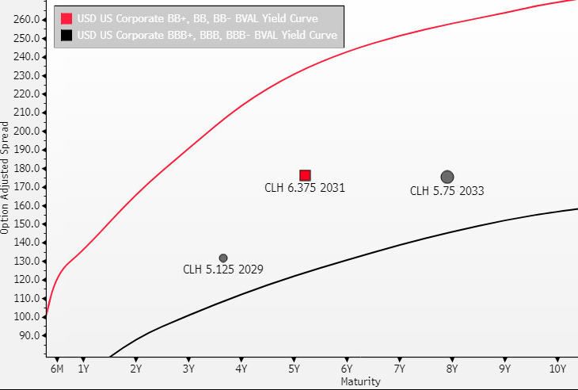
CLH 31s Offer an Attractive 2Y Holding Period Return With a Skew to Upside
 | Bull | Base | Bear | 2027 Call
∆OAS | - 50 bps | - 25 bps | + 25 bps | @ 102
2Y HPR (Annualized) | 6.42% | 6.10% | 5.43% | 5.63%
Source(s): Bloomberg, FactSet, Company Filings

Slide 18
Buy CLH 6.375% 2/01/31
Investment Summary
Bond Info
Moody’s/S&P/Fitch | Ba2/BB+/BB+
Issue Size ($M) | $500
OAS (bps) | 176
YTW | 5.23%
Convexity | 0.05
Modified Duration | 1.99
Thesis 1:
Durable Competitive Advantage Will Drive Strong Credit Metrics Through 2027 and Support a Potential Ratings Upgrade in 2027
Thesis 2:
Clean Harbors Will be Able to Maintain its Strong Credit Profile Even After Financing 2026 and 2027 Acquisitions
 | Bull | Base | Bear
2Y HPR (Annualized) | 6.42% | 6.10% | 5.43%
Source(s): Bloomberg, FactSet, Company Filings

Slide 19
Appendix

Slide 20
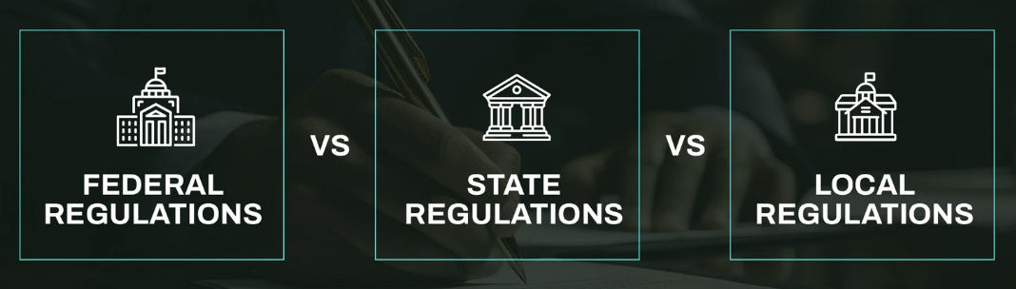
Regulatory Tailwinds
Resource Conservation and Recovery Act (RCRA) Subtitle C provides updated guidelines for end-to-end national management for hazardous waste. Program overseen by EPA with implementation and enforcement done at the state level
Permit Process: 120+ days to obtain and can last up to 10 years
Cost: $20k-$500k
EPA 2024 waste regulation agenda increases scrutiny on waste-recycling streams
State-level oversight may raise stricter rules and regulations
Source(s): Government Filings (U.S. Environmental Protection Agency)

Slide 21
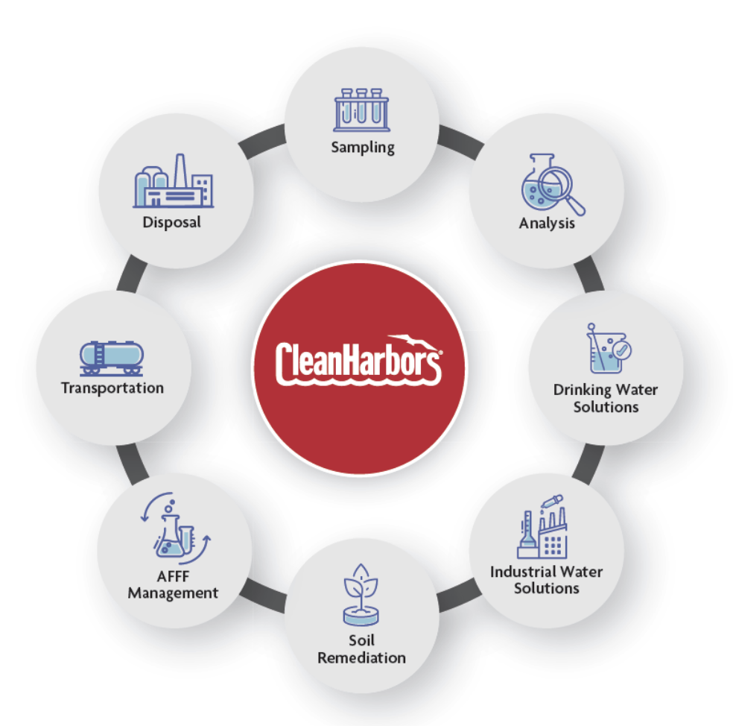
CLH’s Role in Total PFAS Solution Management
Clean Harbors provides the most comprehensive suite of PFAS treatment and destruction services, adhering to the EPA’s 2024 Interim Guidance and additional state-level mandates
With over 100 EPA-permitted facilities, CLH can provide nationwide coverage
Source(s): Bloomberg, FactSet, Company Filings

Slide 22
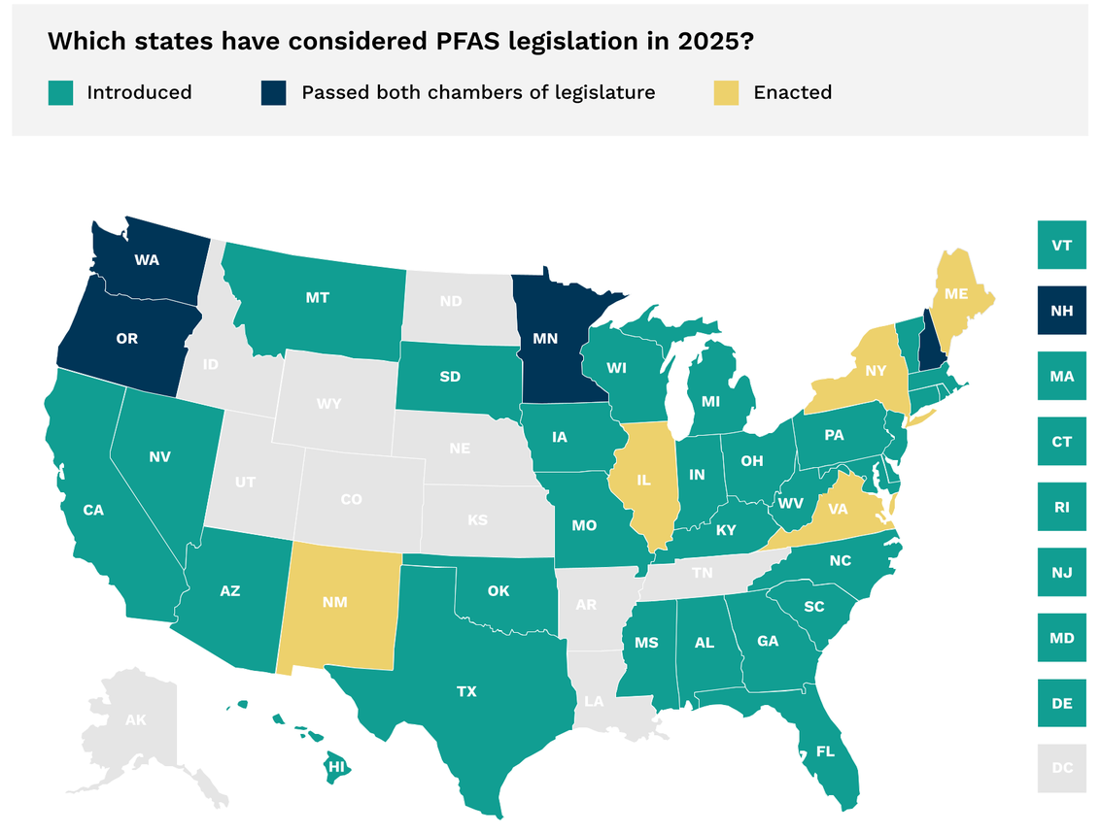
Secular Pressures towards PFAS destruction growing across the United States
In 2025, over 350 bills regarding PFAS have been introduced throughout 39 states
The EPA has provided guidance on the testing of containment, destruction, and disposal through their Interim Guidance for 2024
Source(s): Bloomberg, FactSet, Company Filings

Slide 23



Historical M&A Transactions
Size: $400mn all-cash acquisition
Multiple: 7.1x EV/EBITDA
Year: 2024
Size: $1.25bn all-cash acquisition
Multiple: 8.3x EV/EBITDA
Year: 2021
Size: $69mn all-cash acquisition
Year: 2024
Source(s): Bloomberg, FactSet, Company Filings
Notes:
Recent acquisitions of Hepaco, HydroChemPSC, and Noble Oil enhance vertical integration across environmental services and SKSS segment
Hepaco acquisition strengthens emergency response and remediation network across 17 states

Slide 24
Thesis Point 2: Clean Harbors Will be Able to Maintain its Strong Credit Profile Even After Considering 2026 and 2027 Acquisitions
Commitment to ~2.0x net leverage limits acquisition credit risk through 2027
Case 1: $500mn Acquisitions per Year
Case 2: $1.2bn Acquisitions per Year
Source(s): Bloomberg, FactSet, Company Filings

Slide 25
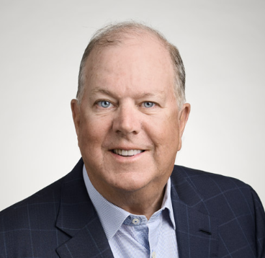
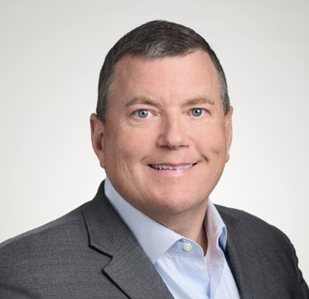
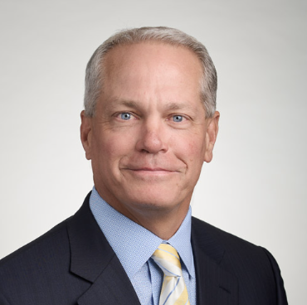
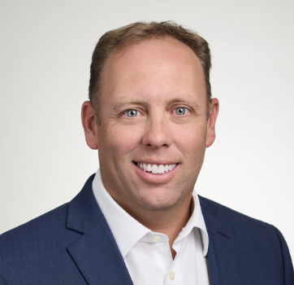
Management Team
Alan S. McKim
Founder, Executive Chairman, and Chief Technology Office
Over 4 decades of experience in the environmental services industry.
Michael L. Battles
Co-Chief Executive Officer
Served as CLH’s Executive Vice President and Chief Financial Office
Has more than 20 years of financial experience
Eric W. Gerstenberg
Co-Chief Executive Officer
Joined CLH in 1989, holding positions of increasing responsibility such as President of the Environmental, Industrial, & Field Services and Chief Operating Officer
Eric J. Dugas
Executive Vice President and Chief Financial Office
Served as CLH’s Senior Vice President, Finance, and Chief Accounting Officer for 5 years
13 years of experience with Deloitte & Touche
Source(s): Bloomberg, FactSet, Company Filings

Slide 26
Income Statement
Source(s): Bloomberg, FactSet, Company Filings

Slide 27
Income Statement Margins and Growth Rates
Source(s): Bloomberg, FactSet, Company Filings

Slide 28
Cash Flow Statement
Source(s): Bloomberg, FactSet, Company Filings

Slide 29
Balance Sheet
Source(s): Bloomberg, FactSet, Company Filings

Slide 30
Liquidity Model
Source(s): Bloomberg, FactSet, Company Filings

